Slide 2
GAI Workflow Lifecycle
Phase 1 – Exploration & Experimentation
Run small-scale PoCs with CompassAI/Workbench or sandbox environments.
Test prompt designs, evaluate output quality, and document caveats.
Establish early human-in-the-loop validation checkpoints.
Phase 2 – Implementation into Development Pipeline
Programmatic integration of GAI via API into dev workflows.
Refine model selection by task; optimize latency and cost.
Deploy supporting infrastructure (vector DBs, observability, monitoring).
Demonstrate value at scale (tens of thousands of samples).
Apply governance & risk management frameworks across the pipeline.
Phase 3 – Maintenance & Evaluation
Continuously update prompts and workflows as new requirements emerge.
Monitor for model drift, data quality issues, and compliance risks.
Introduce feedback loops from user edits or analyst corrections to improve models.
Periodically evaluate against benchmarks and update documentation.
Phase 4 – Distillation & Specialization
Fine-tune SLMs or student models on production-generated datasets.
Build lightweight, domain-specific models for efficiency and portability.
Retire or replace outdated models with updated baselines.
Continue human validation and governance oversight.

Slide 3
GAI Workflow Lifecycle
Phase 1 – Exploration & Experimentation
Run small-scale PoCs with CompassAI/Workbench or sandbox environments.
Test prompt designs, evaluate output quality, and document caveats.
Establish early human-in-the-loop validation checkpoints.
Phase 2 – Implementation into Development Pipeline
Programmatic integration of GAI via API into dev workflows.
Refine model selection by task; optimize latency and cost.
Deploy supporting infrastructure (vector DBs, observability, monitoring).
Demonstrate value at scale (tens of thousands of samples).
Apply governance & risk management frameworks across the pipeline.
Phase 3 – Maintenance & Evaluation
Continuously update prompts and workflows as new requirements emerge.
Monitor for model drift, data quality issues, and compliance risks.
Introduce feedback loops from user edits or analyst corrections to improve models.
Periodically evaluate against benchmarks and update documentation.
Phase 4 – Distillation & Specialization
Fine-tune SLMs or student models on production-generated datasets.
Build lightweight, domain-specific models for efficiency and portability.
Retire or replace outdated models with updated baselines.
Continue human validation and governance oversight.

Slide 4
Techniques & Lessons learned
Model Strategy & Cost Optimization
Matched model to task:
GPT-4o-mini → salience filtering
GPT-4o → full extraction
GPT-4.1 → deduplication, sourcing, clustering
Open-source embeddings (MiniLM-L6-v2) for chunking & retrieval reduced token costs.
Scalable High-Signal Artifacts
Distilled texts into signal-only summaries for model efficiency.
Daily → Weekly → Monthly roll-ups provided scalable and traceable insights.
Used proxy identifiers to avoid token overflow from long UUIDs.
Output Structuring & Formatting
Enforced JSON schemas for reliable machine-readable output.
Prompt precision mattered — quotation style, placeholder use (<initiating_country>).
Embedding markdown metrics/charts in prompts boosted ranking task accuracy.
Sourcing & Claim Verification
Split summarization from sourcing to improve citation fidelity.
Applied TF-IDF narrowing before model claim sourcing.
Deduplication consolidated events while preserving all underlying sources.
Managing Volume & Variety
Preprocessing, chunking, clustering reduced raw reporting overload.
Deduplication avoided event inflation from redundant coverage.
Tiered summarization ensured detailed enrichment only for high-volume events.
Human-in-the-Loop & Governance
Analysts validated high-stakes events and anomalies.
Risk controls prevented unchecked propagation of hallucinated content.

Slide 5
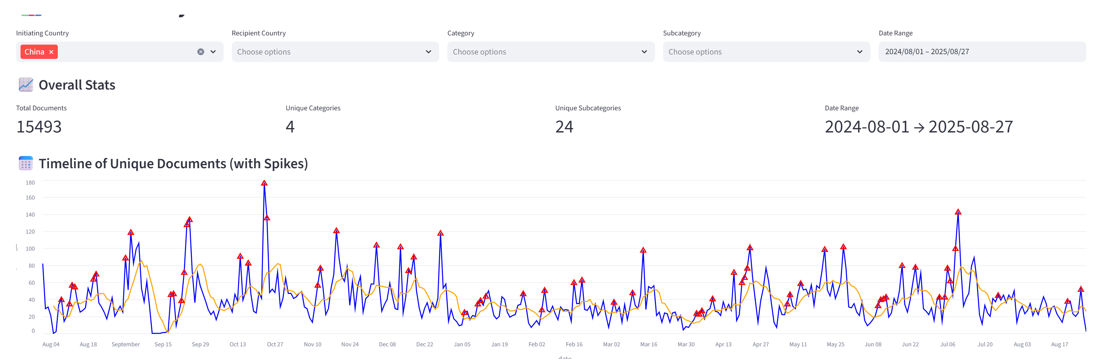

Slide 6
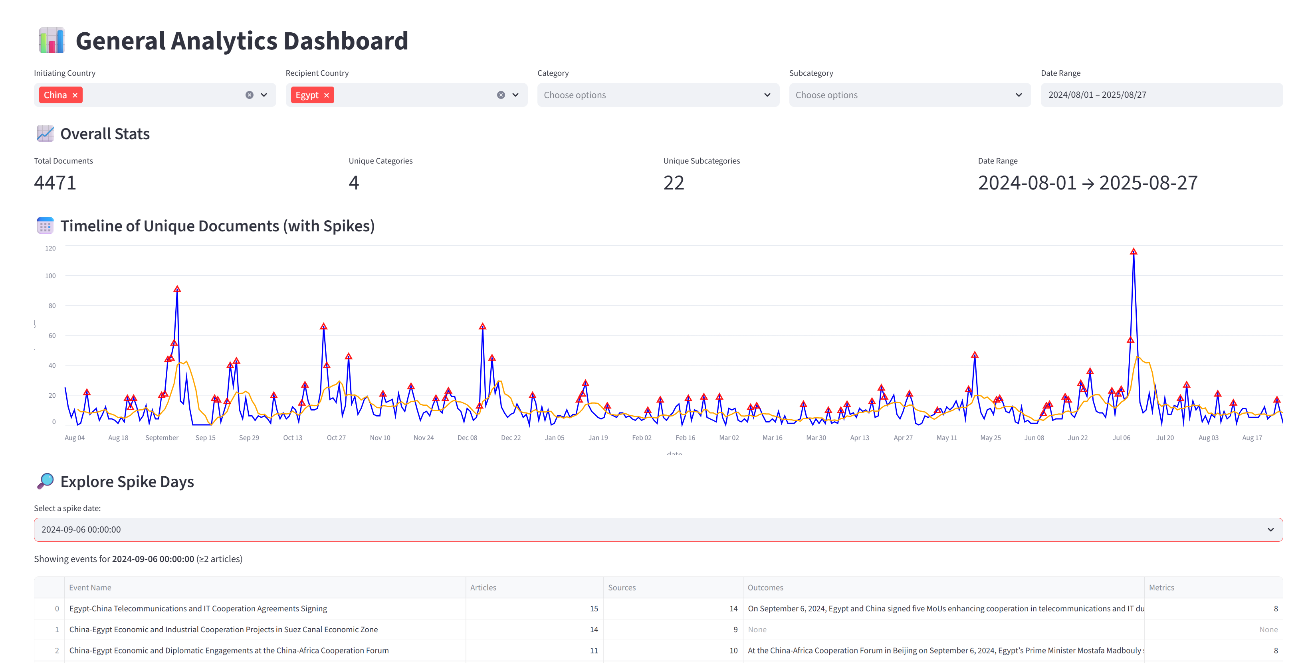

Slide 7
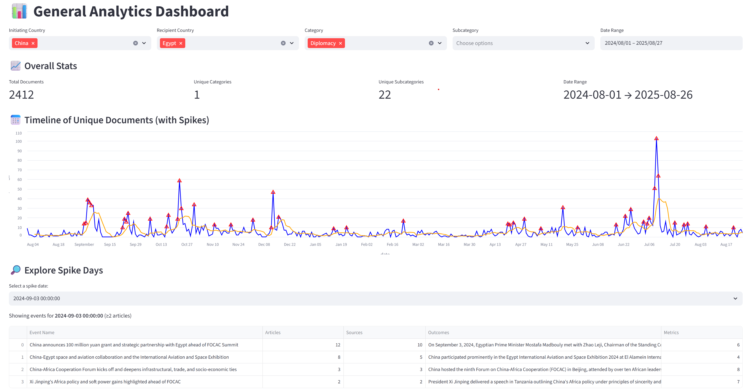

Slide 8
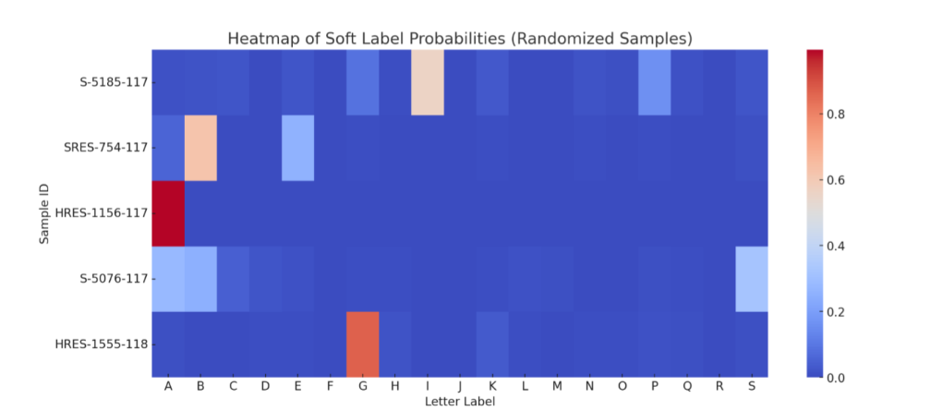
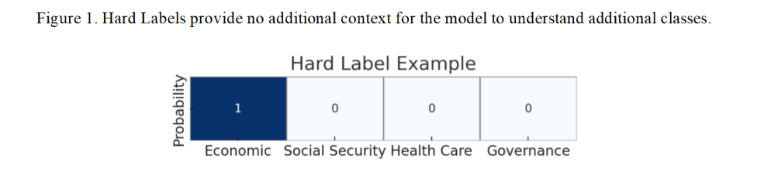
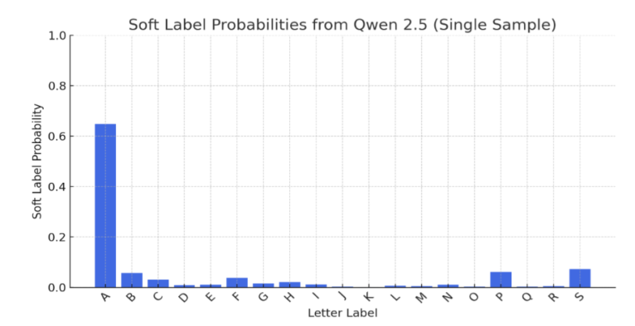
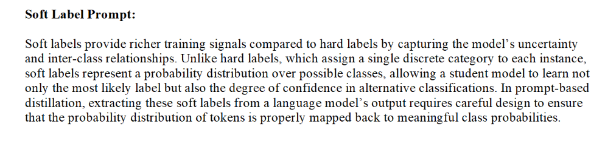
Knowledge Distillation (Classification)

Slide 9
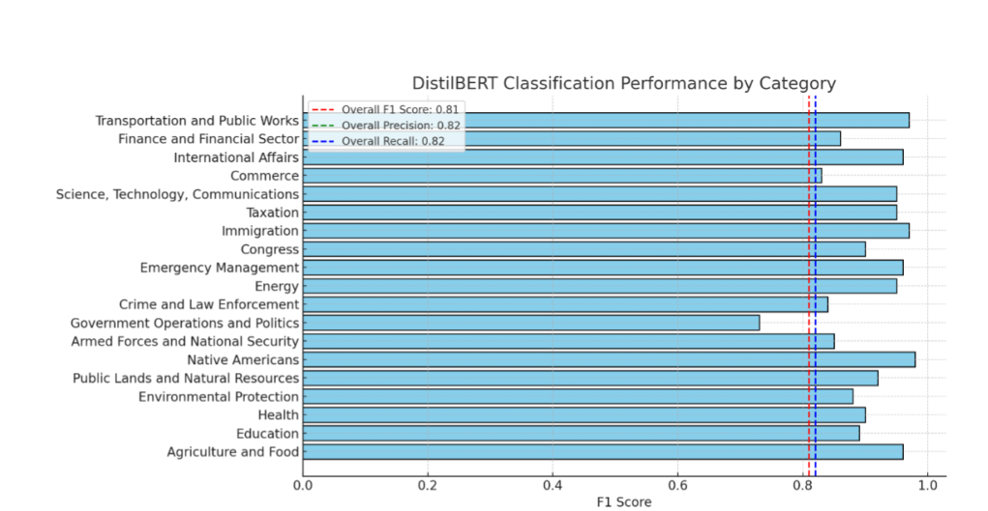
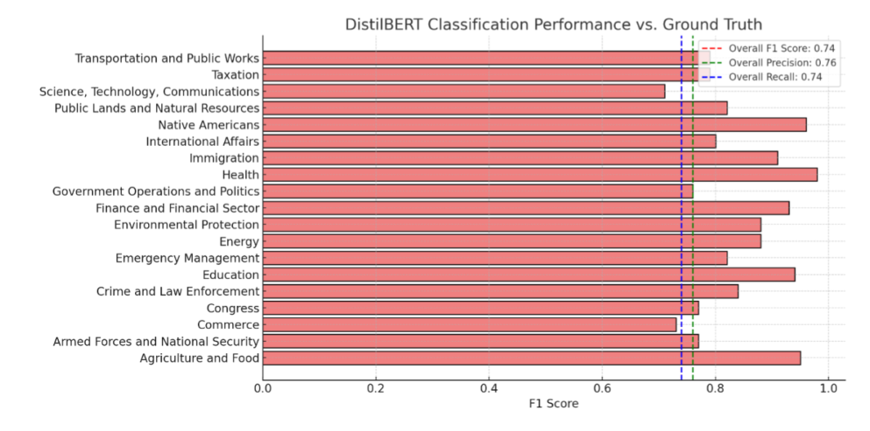
Knowledge Distillation (Cont’d)
When evaluated against GPT 4o’s synthetic labels, our DistilBERT student achieved an overall F1 score of 0.81—closely matching the teacher’s performance with both precision and recall at 0.82. Performance varied by topic, for example Transportation and Public Works led the pack (F1 ≈ 0.97), followed by International Affairs, Science & Technology, and Agriculture & Food (all > 0.95), while Government Operations & Politics was the most challenging category (F1 ≈ 0.71). Across 19 Congressional topics, the student model sustained high accuracy (15 categories > 0.80).

Slide 10
Limitations & Future Directions
Deduplication Fidelity
Current: Monthly fidelity, not ground-truth index
Challenge: Over/under merging events
Future: Hierarchical schemas + batch reprocessing + SME adjudication
Human-in-the-Loop Validation
Current: Limited analyst manpower
Challenge: Continuous review not feasible
Future: Selective validation + confidence metrics + reinforcement learning
Evaluation & Ground Truth Gaps
Current: No balanced dataset; human variance
Challenge: Evaluation remains iterative
Future: Build balanced corpus; overlap checks; refine schema w/ SME input
Cost & Scaling
Current: GPT-4.1 performance high, costs remain high
Challenge: Large-scale ingestion not sustainable
Future: Hybrid frontier + student/open-source models

Slide 11
Batch Deduplication (Deferred):
Deduplication occurs after weeks or months of data have been collected.
Allows events to be evaluated in the context of the larger dataset, supporting higher-confidence consolidations.
Minimizes fragmentation by ensuring the full range of references to an event are considered before assigning a stable identifier.
Drawback: Delays analyst access to fully consolidated events.
Real-Time Deduplication (Streaming):
Deduplication occurs as new articles are ingested.
Events are immediately compared against existing SPIDs, and matches are flagged as updates.
Allows near-instant enrichment of event summaries and metrics.
Drawback: Risks over-consolidation or fragmentation, since the model has less historical context to work with.

